Slide 1
I/O Principles of I/O Hardware

Slide 2
Review
File System
Manages the information stored and hides the complexity on the storage devices
Provides the users access information in a convenient way and a uniform logical view
Is stored on disks
Implementations
File: Contiguous, Linked List, Linked List using a Table in Memory (FAT), i-nodes (same as multi-level paging)
Directory: Fixed size entries, one per file containing file name & attributes
File Name: fixed size, part of block, stored in heap
Utilities:
LFS (write data to end the log and using cleaner thread)
JFS (store log file and using atomic transaction)
VFS (uniform logical view for file system)
Disk Space management
Manage free block – linked list and bitmap
Disk quota: two tables contain open file and user quotas

Slide 3
Review
File System
Implementations
Utilities:
Disk Space management
File consistency: two array, one for block in use, other for free block
Directory consistency: counter file and traversal i-node
Backups, performance – caching
Block read ahead: load block k + 1 to memory when the block k is accessed
Reduce disk arm motion, defragmentation
File
Abstraction, Object and Mechanism
Name, Path (absolute vs. relative), Structure, Type, Access, Attributes, Operations
Directory (Single level vs. Hierarchy)
Sharing
Traditional /hard linking (using one i-node)
Symbolic linking (using larger than one i-node that references to path of file)

Slide 4
Objectives
Principles of I/O Hardware
I/O Devices
Device Controllers
Memory-Mapped I/O
Direct Memory Access (DMA)
Interrupts Revisited

Slide 5
Principles of I/O Hardware
I/O Devices
There are 2 categories: block devices and character devices
Block devices
Store information in fixed-size blocks, each one with its own address
Common block sizes range from 512 bytes to 32.768 bytes
All transfers are in units of one or more entire (consecutive) blocks
The essential property of block device is that it is possible to read or write each block independently of all the others ones
Hard disks, CD-ROMs, and USB sticks
Character devices
Deliver or accept a stream of characters, without regard to any block structure
Is not addressable and does not have any seek operation
Printers, mice …
The model of block and character devices is general enough that they can be used as a basic for making some OS software dealing with I/O device independent
I/O devices cover a huge range in speeds, which puts considerable pressure on the software to perform well over orders of magnitude in data rates

Slide 6
Principles of I/O Hardware
Device Controllers
Is an electronic component in I/O units
Often takes the form of a chip on the parent board or a printed circuit card that can be inserted into a expansion slot
The controller card usually has a connector where the cables can be plugged
Many controllers can handle 2,4,6 or 8 identical devices
If the interface between the controller and device is a standard interface (ANSI, IEEE, ISO), then companies can make controllers or devices that fit that interface (ex: IDE, SATA, SCSI, USB, IEEE 1934)
The interface between the controller and the device is often a very low level interface
The controller’s job to convert the serial bit stream into a block of bytes and perform any error correction necessary

Slide 7
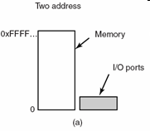
Memory-Mapped I/O
Context
Each controller has a few registers that
Can communicate with the CPU.
Allow to read and write
Many devices have a data buffer allow to read and write
→How the CPU communicates with control registers & device data buffers?
First approach
Each controller register is assigned an I/O port number, an 8/16 bit integer
The set of all the I/O ports form the I/O port space and is protected
CPU can read contents from PORT to store in REG and can write the contents from REG to PORT
→ address spaces for memory and I/O are different
Tanenbaum, Fig. 5-2.

Slide 8
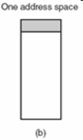
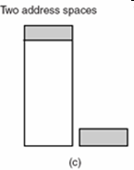
Principles of I/O Hardware
Memory-Mapped I/O
Second approach
Map all the control registers into the memory space
Each control register is assigned a particular and unique memory address (Usually, the assigned addresses are at the top of the address space)
→ memory-mapped I/O with one address space
Combination approach
A hybrid schema, with memory-mapped I/O data buffers and separate I/O ports for the control registers
Tanenbaum, Fig. 5-2.

Slide 9
Principles of I/O Hardware
Memory-Mapped I/O
How do they work?
When the CPU wants to read a word, either from memory or from an I/O port, it puts the address it needs on bus address lines and then asserts a READ signal on a bus' control line
A second signal line is used to tell whether I/O space or memory space is needed
If it is memory space, the memory responds to the request
If it is I/O space, the I/O device responds to the request.
If there is only memory space, every memory module and every I/O device compares the address lines to range of addresses that it services
If the address falls in its range, it responds to the request. Since no address is ever assigned to both memory and an I/O device, there is no ambiguity and no conflict

Slide 10
Principles of I/O Hardware
Memory-Mapped I/O
Advantages
A I/O device driver can be written entire in C (instead of using complexity assembly code)
No special protection mechanism is needed to keep user processes from performing I/O
Every instruction that can reference memory can also reference control registers (using one instruction instead of two)
Disadvantages
Caching a device control register would be disastrous (reference from cache instead of devices → disable cache is a solution)
The I/O devices have no way of seeing memory addresses as they go by on the memory bus, so they have no way of responding to them
The need of figuring out at boot time which memory addresses are not really memory addresses

Slide 11
Principles of I/O Hardware
Direct Memory Access – DMA
Problem
Disk controller reads the block from the drive serially, bit by bit, until the entire block is in the controller’s internal buffer
Disk controller computes the checksum to verify that no read errors have occurred
Disk controller interrupts the CPU to let know that those tasks are completed
CPU reads the disk block from the controller’s buffer a byte or a word at a time by executing a loop, with each iteration reading on byte or word from controller device register and storing it in main memory
→ waste the CPU’s time
Solution
Using DMA

Slide 12
Principles of I/O Hardware
Direct Memory Access – DMA
The DMA controller is integrated into each device
The DMA controller has access to the system bus independent of the CPU
The DMA controller regulates transfers to multiple devices, often concurrently
The acknowledgement is used for each DMA channel to determine the serviced device.
The DMA controller contains several registers
A memory address register
A byte count register
One or more control registers: specify the I/O port to use, the direction of the transfer (read/write from/to I/O device), the transfer unit (byte/word at a time), and the number of bytes to transfer in one burst

Slide 13
Principles of I/O Hardware
Direct Memory Access – DMA – Mechanism
Step 1
The CPU sets the DMA controller registers so DMA knows what to transfer where, and how many transfer
The CPU commands the disk controller read data from disk to internal buffer, then verify the checksum
Step 2
The DMA controller initiates the transfer by issuing a read request over the bus to the disk controller
Step 3
The disk controller transfer a word/ byte from internal buffers to main memory at the address that is described in the DMA’s memory address register
Step 4
The disk controller sends an acknowledgement signal to DMA controller when the write is complete
Simultaneously, the DMA controller decides which device to service next (using RR or priority scheme)
In each transfer, the DMA controller increments the memory addresses to use and decrements the byte count
If the byte count is still greater than 0, step 2 through 4 are repeated until the count reaches 0
If the byte equals 0, the DMA controller interrupts the CPU to let it know the transfer is now complete

Slide 14
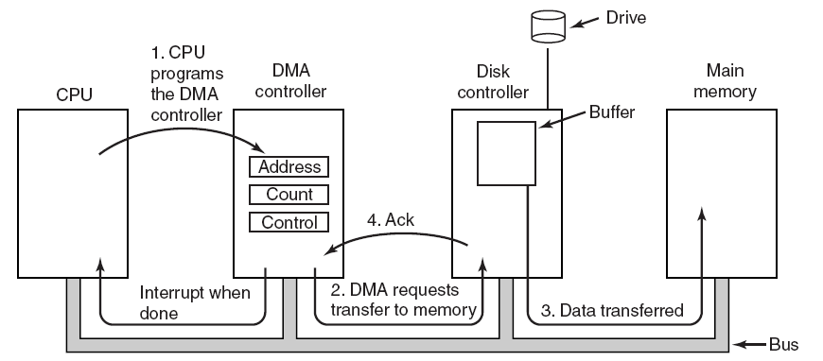
Principles of I/O Hardware
Direct Memory Access – DMA
Tanenbaum, Fig. 5-4.

Slide 15
Principles of I/O Hardware
Direct Memory Access – DMA
DMA can operate in three mode
Word-at-a-time mode
The DMA controller requests for the transfer of and gets one word
Cycle stealing: CPU has to wait the bus because device controller sneaks in and steals an occasional bus cycle from CPU
Block mode
Burst mode: DMA tells the device to acquire the bus, issue a series of transfer, then release the bus (efficiently because transfer multiple words)
Disadvantages: It can be blocked the CPU and other devices with long burst is being transfer
Fly-by mode
DMA tells the device controller to transfer the data directly to main memory
To have the device controller send the word to the DMA controller, an extra bus cycle is provided per word transfer
→ Flexible in performing device to device copies and even memory-to-memory copies (first, read to memory, then write to a memory at a different address)

Slide 16
Principles of I/O Hardware Direct Memory Access – DMA
DMA uses physical memory addresses
OS convert the virtual address of the intended memory buffer into a physical address and write this physical address into the DMA controller’s address register
Or, virtual addresses are written into the DMA controller, then DMA must use MMU to have the virtual-to-physical translation
Why does the controller need an internal buffer?
The disk controller can verify the checksum before starting a transfer (Ensuring that the errors do not occur before transferring)
Reduce the administration data in transfer when the bus were busy (then using DMA transfer because the DMA is not time critical)
Is the DMA faster or the CPU faster?
The CPU is faster and can do the job much faster when the limiting factor is not the speed of the I/O device

Slide 17
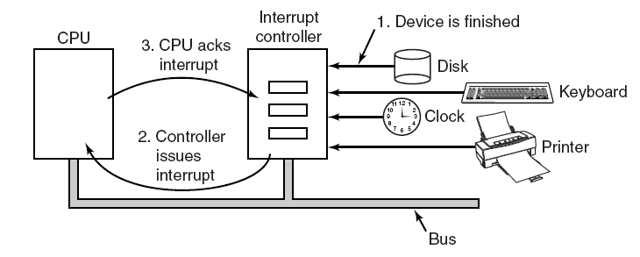
Principles of I/O Hardware
Interrupts Revisited
Tanenbaum, Fig. 5-5.

Slide 18
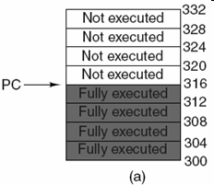
Principles of I/O Hardware
Precise Interrupts
Leave the machine in a well-defined state
There are 4 properties
PC is saved in a known place.
All instructions before the one pointed to by the PC have fully executed.
No instruction beyond the one pointed to by the PC has been executed.
Execution state of the instruction pointed to by the PC is known
There is no prohibition on instructions beyond the one pointed to by the PC from starting.
Any changes make to registers or memory must be undone before the interrupt happens
→ chip is complexity in design
Tanenbaum, Fig. 5-6.

Slide 19
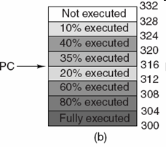
Principles of I/O Hardware
Imprecise Interrupts
Does not meet all requirements as precise
Different instructions near PC are in different stages of completions
Machines with imprecise usually vomit a large amount of internal state onto the stack to give the OS the possibility of figuring out what was going on.
→The code necessary to restart the machine is typically extremely complicated
→Saving a large mount of information to memory on very interrupts make interrupts slow and recovery even worse
Tanenbaum, Fig. 5-6.

Slide 20
Summary
Principles of I/O Hardware
Q&A

Slide 21
Next Lecture
Principles of I/O Software
I/O Software Layers

Slide 22
I/O Principles of I/O Software I/O Software Layers

Slide 23
Review
Memory-Mapped I/O
Map all the control registers into the memory space
Each control register is assigned a particular and unique memory address
DMA
A memory address register
A byte count register
One or more control registers
3 modes: Word-at-a-time, Block, Fly-by
Precise vs. Imprecise Interrupt
Precise: Leave the machine in a well-defined state
PC is saved in a known place
All instructions before the one pointed to by the PC have fully executed
No instruction beyond the one pointed to by the PC has been executed
Execution state of the instruction pointed to by the PC is known
Imprecise: Does not meet all requirements as precise

Slide 24
Objectives
Principles of I/O Software
Goals of the I/O Software
Programmed I/O
Interrupt-Driven I/O
I/O using DMA
I/O Software Layers
Interrupt Handlers
Device Drivers
Device-Independent I/O Software
User-Space I/O Software

Slide 25
Principles of I/O Software Goals of the I/O Software
Device independence
Write program can access any I/O device without having to specify the device
Uniform naming
The name of file or device should simply be a string or an integer and not depend on the device in any way
A path name is used to address
Error handling
The problems,that are not able to deal with hardware, should be told by software
Synchronous (blocking) vs. Asynchronous (interrupt-driven) transfer
User program writes if I/O operation are blocking – after a read system call the program automatically suspended until the data are available in the buffer
The CPU starts transfer & goes off to do something else until the interrupt arrives
Buffering
The data must be put into an output buffer in advance to decouple the rate at which the buffer is filled from the rate at which it is empties, in order to avoid buffer under run
Sharing vs. dedicated devices: OS handle to avoid problems

Slide 26
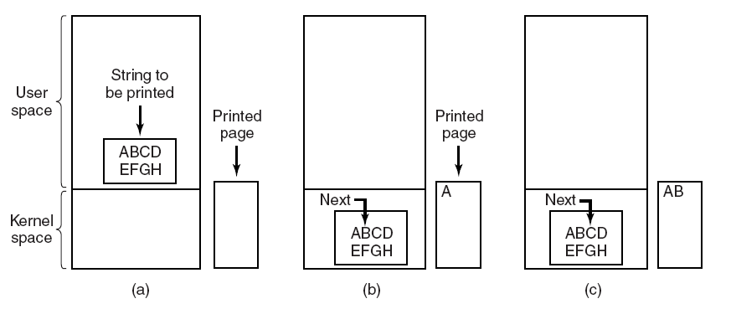
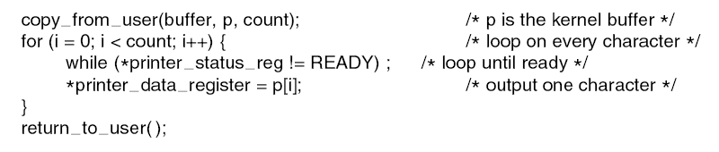
Principles of I/O Software Programmed I/O
The simplest form of I/O is to have the CPU do all the work as
The CPU uses polling to watch the control bit, constantly looping to see whether the device is ready
Making a system call to open the device
If it is available, the data are copied to kernel
Then, CPU polls the device to see if it is ready to accept or not
If it so, the small data is outputted
→tying up the CPU full time until all the I/O is done
Tanenbaum, Fig. 5-7 & 5-8.

Slide 27
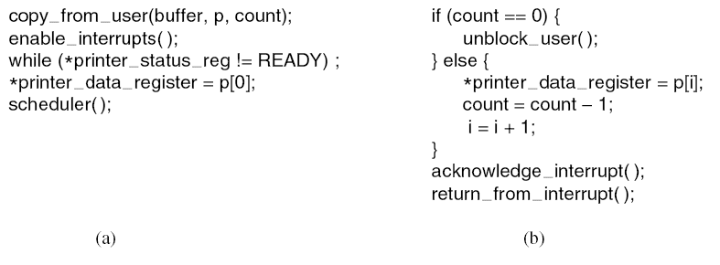
Principles of I/O Software Interrupt-Driven I/O
The way to allow CPU to do something else while waiting for device to become ready is to use interrupts
The CPU does not poll the control bit, it receives an interrupt when the device is ready for next by
Disadvantages: interrupt occurs on every character → wastes a certain amount of CPU time
Tanenbaum, Fig. 5-9.

Slide 28
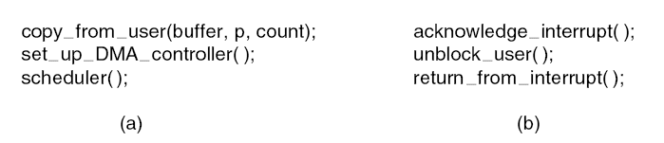
Principles of I/O Software I/O using DMA
Let the DMA controller fetch the characters to device one at time without the CPU being bothered
DMA is programmed I/O
Free ups the CPU during the I/O to do other work
Reducing the number of interrupts and most of the time DMA is worth
→requires special hardware
Tanenbaum, Fig. 5-10.

Slide 29
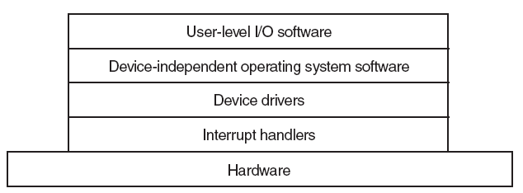
I/O Software Layers Overview
There are 4 layers
Each layer has a well-defined function to perform and a well-defined interface to the adjacent layers
Tanenbaum, Fig. 5-11.

Slide 30
I/O Software Layers Interrupt Handlers
Is a procedure or routine located at fixed address memory
Does whatever it has to in order to handle interrupt
Determines the cause of interrupt
Performs the necessary processing
Executes a return from interrupt instruction to return the CPU to the execution state prior to the interrupt

Slide 31
I/O Software Layers Interrupt Handlers – Example
An outline of a series if steps that must be performed in software after the hardware interrupt has complete
Save registers not already been saved by interrupt hardware.
Set up a context for the interrupt service procedure. (setting up TLB, MMU and page table)
Set up a stack for the interrupt service procedure.
Acknowledge the interrupt controller. If there is no centralized interrupt controller, reenable interrupts.
Copy the registers from where they were saved to the process table
Run the interrupt service procedure. It will extracts information from the interrupting device controller’s register
Choose which process to run next. If the interrupt has caused some high priority process that was blocked to become ready, it may be chosen to run now
Set up the MMU context for the process to run next. Some TLB setup may also be needed
Load the new process’ registers, including its PSW.
Start running the new process

Slide 32
I/O Software Layers Device Drivers
Device driver
Is a device-specific code is used to control and attach the I/O device to a computer
This code is written by the device’s manufacturer and delivered along with the device
Normally handles one device type, or at most, one class of closely related devices
There is no technical restriction on having one device driver control multiple unrelated devices
Is written by outsiders, then will be installed in OS
Are normally positioned below the rest of OS
OS classify drivers into 2 common categories: block devices and character devices
OS define a standard interface supporting all block drivers and a second standard interface supporting all character drivers.
Drivers are not allowed to make system calls, but they often need to interact with the rest of the kernel (calls to certain kernel procedures are permit)

Slide 33
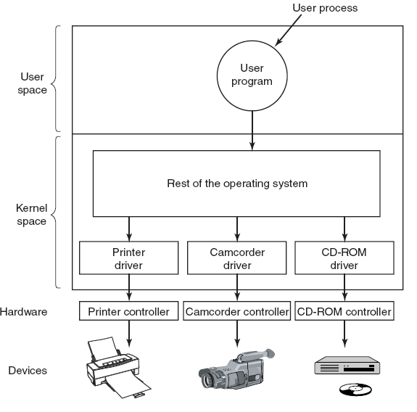
I/O Software Layers Device Drivers
Tanenbaum, Fig. 5-12.

Slide 34
I/O Software Layers Device-Independent I/O Software
The basic function of device-independent software is to perform the I/O functions that are common to all devices and to provide a uniform interface to the user-level software
Some functions as
Uniform interfacing for device drivers
Buffering
Error reporting
Allocating and releasing dedicated devices
Providing a device-independent block size

Slide 35
I/O Software Layers Uniform Interfacing for Device Drivers
Each device driver has different interface to the OS
Driver functions available for system to call differ from driver to driver → differ kernel functions
Taken together, interfacing each new driver requires a lot of new programming effort
All drivers have the same interfaces
It is much easier to plugin a new drivers, providing it conforms to the driver interface
The driver writers know what is expected of them
In practice, not all devices are absolutely identical, but usually there are only a small device types and even these are generally almost the same

Slide 36
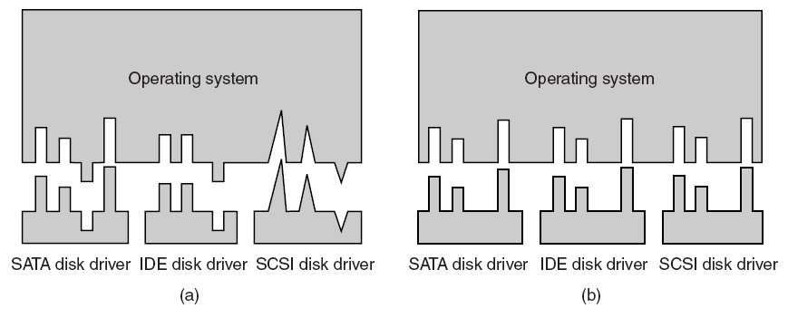
I/O Software Layers Uniform Interfacing for Device Drivers
Tanenbaum, Fig. 5-14.

Slide 37
I/O Software Layers Uniform Interfacing for Device Drivers
A uniform interface is how I/O devices are named
The device-independent software takes care of mapping symbolic device names onto the proper driver

Slide 38
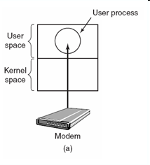
I/O Software Layers Buffering
Is an issue both for block and character devices
Problem
Consider a process that wants to read data from a modem
User process do a read system call and block waiting for 1 character and each arriving character causes an interrupt
The interrupt service hands the character to the user process and blocks it
After putting the character somewhere, the process reads another character and blocks again
→a process must run many times for short runs
Tanenbaum, Fig. 5-15.

Slide 39
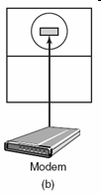

I/O Software Layers Buffering
Buffering in user space
User process provides an n-character buffer in user space
The interrupt service puts the incoming characters in the buffer until it fills up, then wakes up the user processes
Problem
If the buffer is paged out when a character arrives, the buffer could be locked in memory, but if many processes start locking pages in memory, the pool of available pages will shrink and performance will degrade
Buffering inside the kernel
Create a buffer inside the kernel and have the interrupt handler put the characters here.
When the buffer full, the page with the user buffer is brought in, if needed, and the buffer copied there in one operation
Problem
If the kernel buffer is paged out and the user buffer is brought in when a character arrives, there is no place to put them
Tanenbaum, Fig. 5-15.

Slide 40

I/O Software Layers Buffering
Double buffering (inside the kernel)
Two kernel buffers is used, while one is being copied to user space, the other is accumulating new input
Circular buffer
Consists of region of memory and two pointers: one points to the next free work (add new data), other points to the first word of data in the buffer that has not been removed yet (remove and process)
Both pointers wrap around, going back to the bottom when they hit the top
(same as the LSF concept)
Tanenbaum, Fig. 5-15.

Slide 41
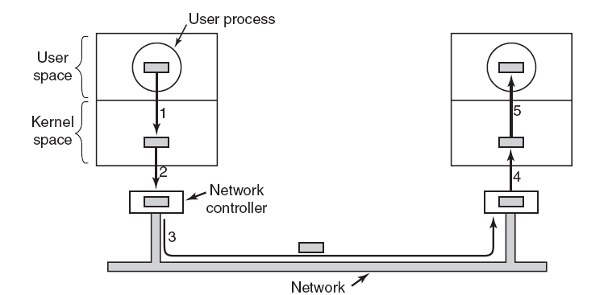
I/O Software Layers Buffering
Buffering is also important on output
The user is free to reuse the buffer the instant it is unblocked
Do not block user in long time (enhance performance) to do something
A downside of buffering
If data get buffered too many times, performance suffers
Slowdown the transmission rate considerably on copying because all the steps process must happen sequentially
Tanenbaum, Fig. 5-16.

Slide 42
I/O Software Layers Error Reporting
Many errors are device-specific and must be handled by the appropriate driver, but the framework for error handling is device independent
I/O Errors
Programming errors
Occurs when a process asks for something impossible
Providing invalid buffer address or other parameter, and specifying an invalid device
→just report back an error code to the caller
Actual I/O Errors
The driver to determine what to do. If it does not know what to do, it may pass the problem back up to device-independent software
When errors occur, the dialog box with message and selected option is showed; or the system display error and terminated

Slide 43
I/O Software Layers Allocating and Releasing Dedicated Devices
Dedicated devices
Are assigned to only one work at a time
To handle the accept or reject requested devices
Process to perform open request on the special files for device directly. If the device is unavailable, the open fails. Closing such a dedicated device then released it
An attempt to acquire a device that is not available blocks the caller instead of failing. Blocked process are put on a queue. Sooner or later, the request device become available and the first process on the queue is allowed to acquire it and continue execution.

Slide 44
I/O Software Layers Device-Independent Block Size
Different disks may have different sector sizes
It is up to the device-independent software to hide this fact and provide a uniform block size to higher layers by treating several sectors as a single logical block
The higher layers only deal with abstract devices that all use the same logical block size, independent of the physical sector size
Similarly, some character devices deliver their data one byte at the time, while others deliver theirs in larger unit

Slide 45
I/O Software Layers User-Space I/O Software
Spooling
Is a way of dealing with dedicated I/O devices in a multiprogramming system
Example for printing task, suppose a process opened it and then did nothing for hours, no other process could print anything
→ the spooling directory (special directory) and daemon (special process)
To print the file, a process first generates the entire file to be printed and puts it in the spooling directory
It is up to the daemon, which is the only process having permission to use the printer’s special file, to print the files in the directory

Slide 46
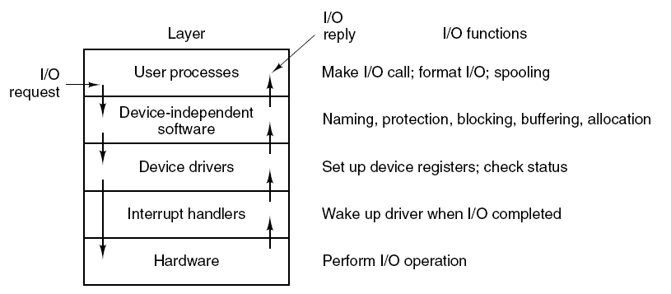
I/O Software Layers Summarize
Tanenbaum, Fig. 5-17.

Slide 47
Summary
Principles of I/O Software
I/O Software Layers
Q&A

Slide 48
Next Lecture
Disks

Slide 49
I/O Disks

Slide 50
Review
Memory-Mapped I/O
Map all the control registers into the memory space
Each control register is assigned a particular and unique memory address
DMA
A memory address register
A byte count register
One or more control registers
3 modes: Word-at-a-time, Block, Fly-by
Precise vs. Imprecise Interrupt
Precise: Leave the machine in a well-defined state
PC is saved in a known place
All instructions before the one pointed to by the PC have fully executed
No instruction beyond the one pointed to by the PC has been executed
Execution state of the instruction pointed to by the PC is known
Imprecise: Does not meet all requirements as precise

Slide 51
Review
I/O Software
Goals
Device Independent, Error handling, Synchronous vs. Asynchronous, Buffering, Dedicated device allocation
I/O with DMA
Layers
User level I/O software: pooling with daemon scheduling (Asynchronous)
Device independent
Uniform naming, Uniform interface, Independent block size
Buffering
Error handling, Dedicated device allocation
Device Drivers: help OS control specified devices depending on standard interface
Interrupt Handlers: handle interrupt to determine what the system should do

Slide 52
Objectives…
Disks
Disk Hardware
Disk Formatting
Disk Arm Scheduling Algorithms
Error Handling
Stable Storage

Slide 53
DISKS Disk Hardware
Magnetic Disks
RAID
CD-ROMs
Disk Formatting
RAID (redundant array of independent disks) is a data storage virtualization technology that combines multiple physical disk drive components into a single logical unit for the purposes of data redundancy, performance improvement, or both.

Slide 54
DISKS RAID
Context
Parallel processing is being used more and more to speed up CPU performance
→ Parallel I/O might be a good idea
→ The Patterson suggested six specific disk organization that could be used to improve disk performance, reliability, or both
Solution: using RAID
Redundant Array of Inexpensive Disks or Redundant Array of Independent Disks
A box full of disks appears as a single large disk
All the drives are controlled using a RAID controller
The data are distributed over the drive to allow parallel operation
RAID consists of a SCSI controller → better performance & better reliability
RAID have 6 schemes from level 0 through level 5

Slide 55

DISKS RAID Level 0
Striping: the virtual single disk is divided up into strips of k sectors each to store data in distributing as
Strip 0: sectors 0 to k – 1
Strip 1: sectors k to 2k – 1
Strip n: sectors nk to (n+1)k – 1
RAID 0 writes consecutive strips over the drives in RR
RAID 0 reads the data from consecutive strips as
The software issues a command to read a data block
RAID controller will bread this command into n separate commands, one for each of the n disks, and have them operate in parallel (→ the parallel I/O without the software knowing about it)
Advantages
Works best with large request, the bigger the better
Performance is excellent and the implementation is straightforward
Disadvantage
Works worst with the OS asking for data one sector at a time
No back up data/disk
Tanenbaum, Fig. 5-20.

Slide 56
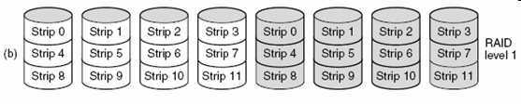
DISKS RAID Level 1
Duplicates all the disks (n primary disks and n backup disks)
On a write, every strip is written twice (slower than single disk)
On a read, either copy can be used, distributing the load over more drives (faster to twice)
The consistency is excellent (applying to crash or recovery)
Tanenbaum, Fig. 5-20.

Slide 57
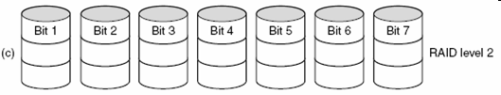
DISKS RAID Level 2
Works on the word or the byte
Split each byte of the single virtual disk into a pair of 4-bit nibbles
Then, add a Hamming code to each one to form a 7-bit word, of which bits 1, 2, and 4 were parity bits
All drives were synchronized in terms of arm position and rotational position
Last, it can write 7 bit Hamming coded word over all drive, 1 bit per drive
Advantages
The total throughput was immense because in one sector time it could write max sectors worth of data (high data rate)
Losing one drive did not cause problems because the Hamming code could handle at runtime
Disadvantages
Requires all drives to be rotationally synchronized, and it only makes sense with a substantial number of drives
Asks a lot of controller since it must do a Hamming checksum every time bit
Tanenbaum, Fig. 5-20.

Slide 58

DISKS RAID Level 3
Is a simplified version of RAID level 2
A single parity bit is computed for each data word and written to a parity drive
The drives must be exactly synchronized since individual data words are spread over multiple drives
The drive crashes and a single parity gives only error detection, not error correction, it provides full 1 bit error correction since the position of the bad bit is known
If a drive crashes, the controller just pretends that its bit are 0s. If a word has a parity error, the bit from the dead drive must have been a 1
Advantage
Offer very high data rates
Disadvantage
The number of separate I/O requests per second they can handle is no better than for a single drive
Tanenbaum, Fig. 5-20.

Slide 59
DISKS RAID Level 4 & Level 5
Work with strips, not individual words with parity and do not require synchronized drives
RAID 4
Is like RAID 0, with a strip-for-strip parity written onto an extra drive
If a drive crashes, the lost bytes can be recomputed from the parity drive by reading the entire set of drives
Protects the loss of a drive but performs poorly for small updates. If one sector is changed, it is necessary to read all the drives in order to recalculate the parity, which must then be rewritten
Optimization, the old user data and the old parity data is read and recompute the new parity from them → small update requires 2 reads and 2 writes
Disadvantages: bottleneck due to the heavy load on the parity drive
RAID 5
The bottleneck is eliminated by distributing the parity bits uniformly over all the drives, RR
If the drive crashes, reconstructing the contents of the failed drive is a complex process

Slide 60
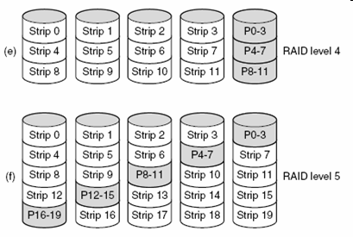
DISKS RAID Level 4 & Level 5
Tanenbaum, Fig. 5-20.

Slide 61
DISKS Disk Arm Scheduling Algorithms
How long disk drivers to read or write a disk block?
The time required is determined by 3 factors
Seek time (the time to move the arm to the proper cylinder)
Rotational delay (the time for the proper sector to rotate under the head)
Actual data transfer time
For most disks, the seek time dominates the other two times, so reducing the mean seek time can improve system performance substantially

Slide 62
DISKS First-Come, First-Served (FCFS)
Process request sequentially
Is intrinsically fair, but it generally does not provide the fastest service
Ex:
A disk queue with requests for I/O blocks on cylinders in orders
98, 183, 37, 122, 14, 124, 65, 67
Assume that the disk head is initially at cylinder 53
Result: 53 98 183 37 122 14 124 65 67
Total head movement of 640 ((98-53)+(183-98)+(183-37)+(122-37)+(122-14)+(124-14)+(124-65)+(67-65))
Average Seek length: 640/8 = 80

Slide 63
DISKS Shortest Seek First (SSF)
Select the disk I/O request that requires the least movement of the disk arm from its current head position
Always choose the minimum seek time
Ex:
A disk queue with requests for I/O blocks on cylinders in orders
98, 183, 37, 122, 14, 124, 65, 67
Assume that the disk head is initially at cylinder 53
Result: 53 65 67 37 14 98 122 124 183
Total head movement of 236 ((65-53)+(67-65)+(67-37)+(37-14)+(98-14)+(122-98)+(122-124)+(183-124))
Average Seek Length: 236/8 = 29.5
Problems
When the SSF is proceeding, the new request, that will have priority overall or next selection, appears. The arm will next go to the new request
With a heavily loaded disk, the arm will tend to stay in the middle of the disk most of the time, so requests at either extreme will have to wait until a statistical fluctuation in the load causes there to be no request near the middle. → Request far from the middle may get poor services. The goals of minimal response time and fairness are in conflict here

Slide 64
DISKS Elevator algorithms
Arm moves in one direction only, satisfying all outstanding requests until it reaches the last track in that direction
Direction is reversed
Requires the software to maintain 1 bit: the current direction bit, UP and DOWN
When a request finishes, the disk or elevator driver checks the bit.
If it is UP, the arm or the cabin is moved to the next highest pending request
If no requests are pending at higher positions, the direction bit is reversed
When the bit is set to DOWN, the move is to the next lowest request position, if any

Slide 65
DISKS Elevator algorithms
Ex:
A disk queue with requests for I/O blocks on cylinders in orders
98, 183, 37, 122, 14, 124, 65, 67
Assume that the disk head is initially at cylinder 53
Result with bit is DOWN:
53 37 14 65 67 98 122 124 183
Total head movement of 208 ((53-37)+(37-14)+(65-14)+(67-65)+(98-67)+(122-98)+(124-122)+(183-124))
Average Seek Length: 208/8 = 26
Result with bit is UP:
53 65 67 98 122 124 183 37 14
Total head movement of 299 ((65-53)+(67-65)+(98-67)+(122-98)+(124-122)+(183-124)+(183-37)+(37-14))
Average Seek Length: 299/8 = 37.375
The elevator algorithms has is that given any collection of requests, the upper bound on the total motion is fixed: it is just twice the number of cylinders

Slide 66
DISKS Elevator algorithms
A slight modification of elevator algorithms that has a smaller variance in response time is to always scan in the same direction
When the highest numbered cylinder with a pending request has been services, the arm goes to lowest number cylinder with a pending request and then continues moving in an upward direction
In effect, the lowest-number cylinder is thought of as being just above the highest-number cylinder
Ex:
A disk queue with requests for I/O blocks on cylinders in orders
98, 183, 37, 122, 14, 124, 65, 67
Assume that the disk head is initially at cylinder 53
Result: 53 65 67 98 122 124 183 14 37
Total head movement of 153 ((65-53)+(67-65)+(98-67)+(122-98)+(124-122)+(183-124)+(37-14))
Average Seek Length: 153/8 = 19.125

Slide 67
DISKS Disk Arm Scheduling Algorithms
Some disks controller provide a way for the software to inspect the current sector number under the head
If two or more requests for the same cylinder are pending, the driver can issue a request for the sector that will pass under the head next
The controller can select any of its heads almost instantaneously
If the seek time is much faster than the rotational delay
Pending request should be sorted by sector number, and as soon as the next sector is about to pass under the head, the arm should be zipped over the right track to read or write it
When several drives are present on the same controller, the OS should maintain a pending request table for each drive separately
Whenever any drive is idle, a seek should be issued to move its arm to the cylinder where it will be needed next
When the current transfer finishes, a check can be made to see if any drives are positioned on the correct cylinder
If one or more are, the next transfer can be started on a drive that is already on the right cylinder
If none of the arms is in the right place, the driver should issue a new seek on the drive that just completed a transfer and wait until the next interrupt to see which arm gets to its destination first

Slide 68
DISKS Disk Arm Scheduling Algorithms
All the disk scheduling algorithms tacitly assume that the real disk geometry is the same as the virtual geometry
If it is not, then scheduling disk requests makes no sense because the OS cannot really tell whether cylinder 40 or cylinder 200 is closer to cylinder 39
On the other hand, if the disk controller can accept multiple outstanding requests, it can use these scheduling algorithms internally. In that case, the algorithms are still valid, but one level down, inside the controller

Slide 69
DISKS Error Handling
Bad sector
Sectors do not correctly read back the value just written to them
If the defect is very small, the bad sector can be used
Otherwise, the error cannot be masked
Substituted the bad sector
Controllers
Remap the bad sector to the spare
Shift all the sectors up one
The information about the substitution of the bad sector is kept track through internal tables or by rewriting the preambles to give the remapped sector numbers (besides, the data must be copied)
When defect occurs at normal operation (may be specks of dust), if getting repeated errors on a certain sector, controller can switch to a spare before the sector has died completely
OS
Must first acquire a list of bad sectors, either reading them from the disk, or simply testing the entire disk itself
Once it knows, the OS can build remapping tables

Slide 70
DISKS Error Handling
Bad sector (cont)
Problem: backup
File to file: OS has to hide the bad block file so well that even a backup utility cannot find it
Sector to Sector: impossible except that the only hope that the backup program has enough smarts to give up after 10 failed reads and continue with next sector
Seek errors
Caused by mechanical problems in the arm occur
The controller keeps track of the arm position internally
To perform seek, it issues a series of pulses to the arm motor, on pulse per cylinder, to move the arm to the new cylinder.
When the arm gets to its destination, the controller reads the actual cylinder number from the preamble of the next sector.
If the arm is in the wrong place, a seek error has occurred
Solutions
Most hard disk controller correct seek errors automatically, but most floppy controllers just set an error bit and leave the rest to the driver.
The driver handles this error with particular command to move the arm as far out as it will go and reset the controller’s internal idea of the current cylinder to 0
If it does not, the driver must be repaired

Slide 71
DISKS Stable Storage
A system has the following properties
When a write is issues to it, the disk either correctly writes the data or it does nothing, leaving the existing data intact
Is implemented in software
The goal is to keep the disk consistent at all costs
Assume that the errors can not detected at the disk written (the errors can be detected on a subsequent read)
Assume that a correctly written sector can spontaneously go bad and become unreadable → small enough to ignore (so rarely)
Assume the CPU can fail or just stops.
Any disk writes in process at the moment of failure also stops, leading to incorrect data in one sector and an incorrect ECC that can later be detected.
Under all these conditions, stable storage can be made 100% reliable in the sense of writes either working correctly or leaving the old data in place

Slide 72
DISKS Stable Storage
Uses a pair of identical disks with the corresponding blocks working together to form one error-free block
In the absence of errors, the corresponding blocks on both drives are the same
Either one can be read to get the same result
Three operations
Stable writes
Write block on drive 1, then reading it back to verify written correctly
If not correctly, the write and reread are done until they work
After consecutive failures, the block is remapped onto a spare and the operation repeated until it succeeds, no matter how many spare have to be tried
After succeeded on drive 1, the driver 2 is written and reread until it succeeds
In the absence of CPU crashes, when a stable write completes, the block has correctly been written onto both drives and verified on both of them

Slide 73
DISKS Stable Storage
Stable reads
First read block on drive 1 in n times
If all of these give bad ECCs, reading on drive 2
Given the fact that a successfully stable write leaves 2 good copies of the block behind, and our assumption that the probability of the same block spontaneously going bad on both drives in a reasonable time interval is negligible, a stable read always succeeds
Crash recovery
After a crash, a recovery program scans both disks comparing corresponding blocks
If a pair of blocks are both good and the same, nothing is done
If one of them has an ECC error, the bad block is overwritten with the good blocks
If a pair of blocks are good but different, the block from driver 1 is written onto drive 2
In the absence of CPU crash, stable storage always works because stable writes always write two valid copies of every block and spontaneous errors are assumed never to occur both corresponding blocks at the same time

Slide 74
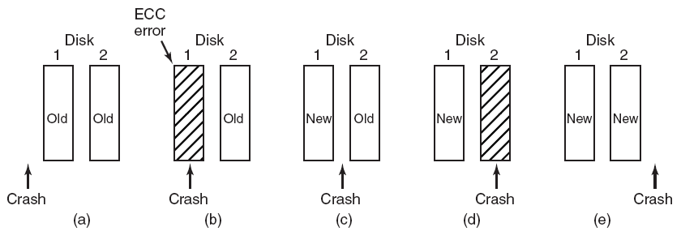
DISKS Stable Storage
Tanenbaum, Fig. 5-31.

Slide 75
DISKS Stable Storage
Optimizations and improvements
Comparing all the blocks pairwise after a crash is doable, but expensive
A huge improvement is to keep track of which block was being written during a stable write so that only one block has to be checked during recovery
In system with Nonvolatile RAM,
The stable write can put the number of block in RAM before starting the write
After completed, the block number in RAM is overwritten with an invalid block.
Under these conditions, after a crash, the recovery can check RAM to see if a stable write happened to be in progress during the crash
→ two copies of the block can then be checked for correctness and consistency
If nonvolatile RAM is not available
At the start of a stable write, a fixed disk block on drive 1 is overwritten with the number of block to be stably written. Then read back and verify.
If is so, write 2 and verify. After completed, both blocks are overwritten with an invalid block number and verified
→ it is easy to determine whether or not a stable write was in progress during the crash
→ requires extra disk operations to write a stable block → should be used exceeding sparingly

Slide 76
Summary
Disks
Q&A

Slide 77
Next Lecture
Clock
Hardware and Software
Soft Timers
User Interfaces
Input & Output Software

Slide 78
I/O Clocks User Interfaces

Slide 79
Review
Memory-Mapped I/O
Map all the control registers into the memory space
Each control register is assigned a particular and unique memory address
DMA
A memory address register
A byte count register
One or more control registers
3 modes: Word-at-a-time, Block, Fly-by
Precise vs. Imprecise Interrupt
Precise: Leave the machine in a well-defined state
PC is saved in a known place
All instructions before the one pointed to by the PC have fully executed
No instruction beyond the one pointed to by the PC has been executed
Execution state of the instruction pointed to by the PC is known
Imprecise: Does not meet all requirements as precise

Slide 80
Review
I/O Software
Goals
Device Independent, Error handling, Synchronous vs. Asynchronous, Buffering, Dedicated device allocation
I/O with DMA
Layers
User level I/O software: pooling with daemon scheduling (Asynchronous)
Device independent
Uniform naming, Uniform interface, Independent block size
Buffering
Error handling, Dedicated device allocation
Device Drivers: help OS control specified devices depending on standard interface
Interrupt Handlers: handle interrupt to determine what the system should do

Slide 81
Review
Disk arm scheduling
Seek time
FCFS: Process request sequentially
SSF: the least movement of the disk arm from its current head position
Elevator
Approach: Arm moves in one direction only, satisfying all outstanding requests until it reaches the last track in that direction
Implementation: When the highest numbered cylinder with a pending request has been services, the arm goes to lowest number cylinder with a pending request and then continues moving in an upward direction
Rotational delay
If two or more requests for the same cylinder are pending, the driver can issue a request for the sector that will pass under the head next
The OS should maintain a pending request table for each drive, a seek should be issued to move its arm to the cylinder where it will be needed next
Actual data transfer time (SATA)

Slide 82
Review
Disk arm scheduling
Error handling
Bad sector
Sectors do not correctly read back the value just written to them
Controllers remap the bad sector to the spare and/or Shift all the sectors up one
OS must first acquire a list of bad sectors, then it can build remapping tables
Seek errors
Move the arm as far out as it will go and reset the controller’s internal idea of the current cylinder to 0

Slide 83
Review
Disk arm scheduling
Disk Consistency
Stable write: Write block on drive 1, then reading it back to verify. The driver 2 is written and reread until it succeeds
Stable read: First read block on drive 1 in n times. If all of these give bad ECCs, reading on drive 2
Crash recovery: scans both disks comparing corresponding blocks. Bad block is overwritten with the good blocks or block from driver 1 is written onto drive 2
Optimizing: using Nonvolatile/ Volatile RAM to replace in using driver 2

Slide 84
Objectives
Clocks
Clock Hardware
Clock Software
Soft Timers
User Interfaces
Input Software
Output Software

Slide 85
Clocks
Overview
Is also call timers
Are essential to the operation of any multi-programmed system
Maintain the time of day and prevent one process from monopolizing the CPU, among other things
The clock software take the form of a device driver, even though a clock is neither a block device nor a character device

Slide 86
Clocks
Clock Hardware
Structure
The simpler clocks are tied to the 110-120 volt power line and cause an interrupt on every voltage cycle at 50-60Hz
Is built out of three components: a crystal oscillator, a counter, and a holding register
When a piece of quartz crystal is properly cut and mounted under tension, it can be made to generate a periodic signal of very great accuracy, typically in the range of several hundreds MHz
Using electronics, this base signal can be multiplied by a small integer to get frequencies up to 1000MHz or even more
At least one such circuit is usually found in any computer, providing a synchronizing signal to the computer’s various circuits.
This signal is fed into the counter to make it count down to zero. When the counter gets to zero, it causes a CPU interrupt

Slide 87
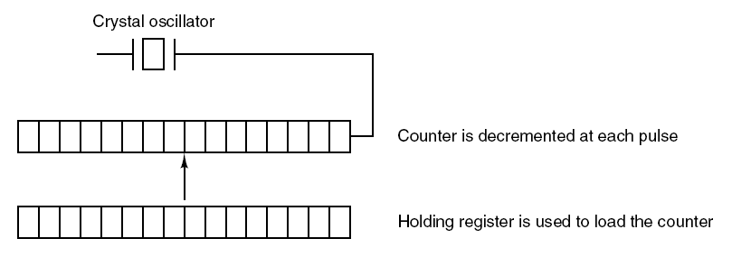
Clocks
Clock Hardware
Tanenbaum, Fig. 5-32.

Slide 88
Clocks
Clock Hardware
Programmable clocks typically have several modes of operation
One-shot mode
When the clock is started, it copies the value of the holding register into the counter and then decrements the counter at each pulse from the crystal
When the counter gets to zero, it cause an interrupt and stops until it is explicitly started again by the software
Square-wave mode
After getting to zero and causing the interrupt, the holding register is automatically copied into the counter, and the whole process is repeated again indefinitely
These periodic interrupts are called clock ticks
Advantages
Its interrupt frequency can be controlled by software
If a 500MHz crystal is used, then the counter is pulse every 2nsec. With unsigned 32 bit registers, interrupts can be programmed to occur at intervals from 2 – 8.6 nsec
Contain two or three independently programmable clocks

Slide 89
Clock
Clock Software
All the clock hardware does is generate interrupts at known intervals
Everything else involving time must be done by the software, the clock driver
Typical duties of a clock driver
Maintaining the time of day (real time).
Just requires incrementing a counter at each clock ticks
Problem: With a clock rate of 60Hz, a 32 bit counter will overflow in just over 2 years → the system cannot store the real time as the number of tick since 1th, Jan, 1970
Solution
First Approach: using 64 bit count → maintaining the counter more expensive since it has to be done many time in seconds
Second Approach: maintain the time of days in seconds, rather than in tick, using a subsidiary counter to count ticks until a whole second has accumulated → 136 years (2³² seconds)
Third Approach: count in ticks, but to do that relative to the time the system was booted, rather than relative to a fixed external moment. In the system boot time, the current time of day value and store in memory. Later, when the time of day is requested, the stored time of day is added to the counter to get the current time of day

Slide 90
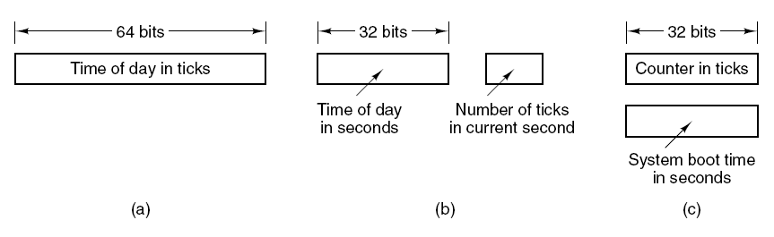
Clocks
Clock Hardware
Tanenbaum, Fig. 5-33.

Slide 91
Clock
Clock Software
Typical duties of a clock driver (cont)
Preventing processes from running longer than they are allowed to.
When a process is started, the scheduler initializes a counter to the value of that process’ quantum in clock ticks
At every clock interrupt, the clock driver decrements the quantum counter by 1.
When it gets the zero, the clock driver call the scheduler to set up another process
Accounting for CPU usage.
First Approach: Using a second timer (distinct with system timer) to calculate how long the process has run from the process is started to be stopped
Second Approach (too expensive and rarely done)
A less accurate, but simpler, way to do accounting is to maintain a pointer to the process table entry for currently running process in a global variable. At every clock tick, a field in the current process’ entry is incremented
Problem: if many interrupts occur during a process’ run, it is still charged for a full tick, even though it did not get much work done

Slide 92
Clock
Clock Software
Typical duties of a clock driver (cont)
Handling alarm system call made by user processes.
A process can request that the OS give it warning after a certain interval, using a signal, interrupt, message, etc … (e.g acknowledged signal)
To implement, a table is used to kept the pending timers. A table is maintained as well as variable giving the time of the next times. Whenever the time of day is updated, the driver checks to see if the closest signal has occurred. If it has, the table searched for the next timer to occur
Providing watchdog timers for parts of the system itself.
OS also need to set timer to cause an interrupt after a sufficiently long time interval
Doing profiling, monitoring, statistics gathering
Os provides a mechanism by which a user program can have the system build up a histogram of its program counter, so it can see where it is spends its time
When profiling is a possibility, at every stick the driver can checks to see if the current process is being profiled, and if so, the bin number corresponding to the current PC. It then increments that bin by one

Slide 93
Clock
Soft Timers
Avoid interrupts
An OS facility that allows efficient scheduling of software events at microsecond granularity
Whenever the kernel is running for some other reason, just before it return to user mode it checks the real time clock to see if a soft timer has expired
If the timer is expired, the scheduled event is performed, with no need to switch into kernel mode since the system is already there
As in the case when the system is already context-switched to the kernel… why not see if other work can be done “while you’re in there?”
After performed, the soft timers is reset to go off again
All that has to be done is copy the current clock value to the timer and add the timeout interval to it
Soft timers stand or fall with the rate at which kernel entries are made for other reasons
System calls
TLB misses
Page faults
I/O interrupts
The CPU going idle

Slide 94
User Interfaces
Input Software
Keyboard Software
Scan code: The number in the I/O port represented 7 bits (8th bit is used to represent key press – 0 or release – 1)
When any key struck, the scan code is put in an I/O register. It is up the driver to determine whether it is lower case, upper case, or the combination.
Although key board interfaces puts the full burden on the software, it is extremely flexible
Two possible philosophies can be adopted for the driver
Raw mode/ character oriented/ noncanonical mode: the driver is just to accept input and pass it upward unmodified
Cooked mode/ line oriented/ canonical mode: the driver handles all the intraline editing, and just delivers corrected lines to the user programs

Slide 95
User Interfaces
Input Software
Keyboard software
Echoing
Many users have grown accustomed to seeing the characters they have just typed appear on the screen
Is complicated because at the very least, the keyboard driver has to figure out where to put the new input without it being overwritten by program output
Get complicated when more than 80 characters have to be displayed in a window with 80 character lines (wrapping around or throwing away)
Tab handling
The driver compute where the cursor is currently located, taking into account both output from programs and output from echoing,
And compute the proper number of spaces to be echoed

Slide 96
User Interfaces Input Software
Keyboard Software
Device equivalence
Logically, at the end of a line of text, one wants a carriage return, to move the cursor back to column 1, and a linefeed, to advance to the next line
If standard form is just to store a linefeed, then carriage returns should be turned into linefeeds (UNIX)
If the internal format is store both, then driver should generate a linefeed when it gets a carriage return and a carriage return when it gets a linefeed
No matter what the internal convention, the monitor may require both a linefeed and a carriage return to be echoed in order to get the screen updated properly

Slide 97
User Interfaces
Mouse Software
Whenever a mouse has moved a certain minimum distance in either direction or a button is depressed or released, a message is sent to the computer (picking up and put down is not)
The message usually occupies 3 bytes containing 3 items
Δx: the change in x position since the last message
Δy: the change in y position since the last message
Buttons: the status of button
Mickey is the unit representing minimum distance about 0.1mm
Most mice report back a maximum of 40 times/sec
Mouse only indicates changes in position, not absolute position itself
The single or double click is distinguished by the software setting

Slide 98
User Interfaces Output Software
Text Windows
The program sends characters to the characters to current windows and they are display there. Usually, a block a character is written in one system call
Screen editors and many other sophisticated programs need to be able to update the screen in complex ways such as replacing one line in the middle of the screen (driver must support escape sequences to move the cursor, insert and delete character …)
Termcap (Berkeley UNIX) defines a number of basic actions that uses a generic escape sequence, the converted to the actual escape sequences
How might the escape sequences be used by a text editor?
After the user types command, the editor might send the escape sequence over the serial line to the terminal
The execution is done

Slide 99
User Interfaces Output Software
The X Window System
The user interface is used all UNIX System
Is very portable and run entirely in user space
Was intended for connecting a large number of remote user terminals with a central compute server, so it is logically split into client and host software
Is not a complete GUI (must be more supported)
X server (local PC, just does what the X Client told)
The software collects input from keyboard and mouse and writes output to the screen
Inside the user’s computer
Displaying bits on the screen
X clients (remote machine)
Running programs
Tells the server to do things, like display text or geometric figures

Slide 100
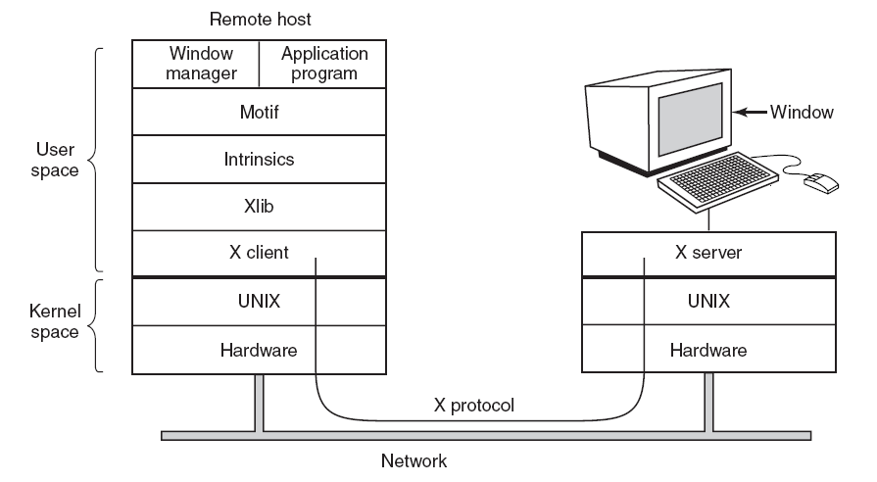
User Interfaces
Output Software
Tanenbaum, Fig. 5-537

Slide 101
User Interfaces Output Software
Graphic Users Interface – GUI
Has four essential elements WIMP (Windows, Icons, Menus, and Pointing device)
The GUI software can be implemented in either user-level code (UNIX) or in the OS itself (Windows)
Windows programs are message oriented
Output almost always goes to a special hardware – graphics adapter
Containing video RAM that holds the image appear on the screen
Support some number of screen sizes
Window
The basic item on the screen is a rectangular area (that can be resized, scrolled)
Its position and size are uniquely determined by giving the coordinates (in pixel) of two diagonally opposite corners
Its coordinate system puts the origin in the upper left-hand corner and has y increase downward

Slide 102
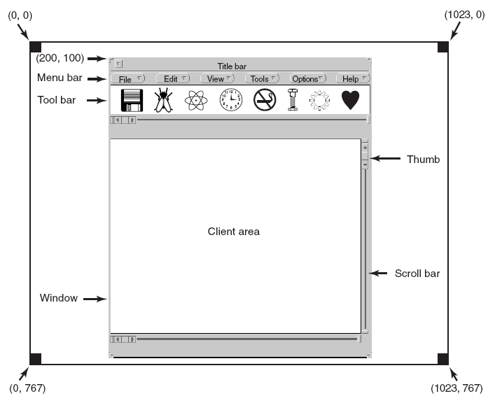
User Interfaces Output Software
Tanenbaum, Fig. 5-39.

Slide 103
User Interfaces Output Software
Bitmaps
The average red, green, and blue values of each grid square are then sampled and saved as the value of one pixel
Use for text
Represent a particular character in some font is as a small bitmap
Adding text to the screen then becomes a matter of moving bitmaps
Problems
They do not scale
Copying between devices with different color properties or between monochrome and color does not work well
Solutions
Windows supports a DIB (Device Independent Bitmap) data structure on file .bmp. Those files have file and information headers and color table before the pixels → the information make easier to move bitmaps between dissimilar devices

Slide 104
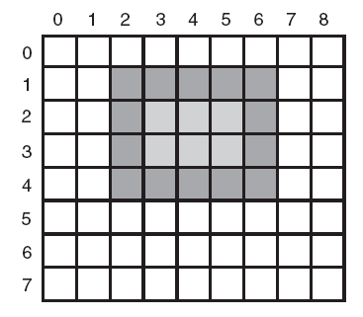
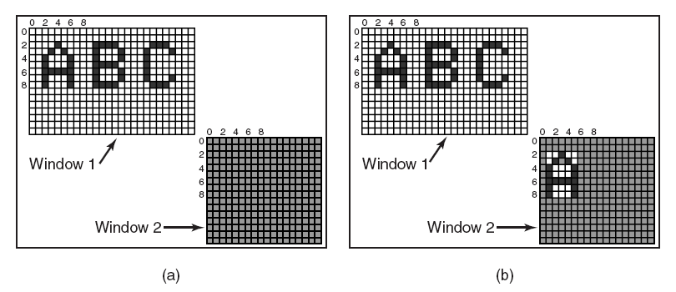
User Interfaces Output Software
Tanenbaum, Fig. 5-41 & 5-42.

Slide 105
User Interfaces Output Software
Fonts
Characters were represented as bitmaps and copied onto the screen or printer
Problems
We just saw, is that a bitmap that makes sense on the screen is too small for the printer
A different bitmap is needed for each character in each size
Solutions
TrueType fonts is introduction which are not bitmaps but outlines the character
Each TrueType character is defined by a sequence of points around its perimeter. All the points are relative to the (0, 0) origin
It is easy to scale the characters up or down with any point size (even fraction)
All that has to be done is to multiply each coordinate by the same scale factor

Slide 106

User Interfaces Output Software
Tanenbaum, Fig. 5-12.

Slide 107
Summary
Clocks
User Interfaces
Q&A

Slide 108
Next Lecture
Thin Clients
Power Management

Slide 109
I/O Thin Clients Power Management

Slide 110
Objectives
Thin Clients
Power Management

Slide 111
Thin Clients
Is called THINC
The most users want high performance interactive computing, do not really want to administer a computer
The user machines had no software at all
Strip the client machine of all it smarts and software and just use it as a display, with all the computing done on the server side
The protocol between client and the server just tells the display how to update the video RAM, nothing more
On the server side, graphical programs use high level command to paint the screen. These are intercepted by THINC software and translated into commands that can be sent to the client. The commands may be reordered to improve efficiency

Slide 112
Power Management Overview
There are 2 general approaches to reducing energy consumption
The OS turn off parts of the computer when they are not in use because a device that is off uses little or no energy
The application program to use less energy, possibly degrading the quality of the user experience, in order to stretch out battery time

Slide 113
Power Management OS Issues
The OS controls all devices and must decide what to shut down and when to shut down
If it shuts down a device and that device is needed again quickly, there may be an annoying delay while it is restarted
If it waits too long to shut down a device, energy is wasted for nothing
The trick is to find algorithms and heuristics that let the OS make “good” decision about what to shut down and when

Slide 114
Power Management Display
The biggest spenders item of the energy budget
Many OS attempt to save energy here by shutting down the display when there has been no activity for some number of minutes
The user can often decide what the shutdown interval is, thus pushing the trade-off between frequent blanking of the screen and using the battery up quickly back to the user
Turn off the display is a sleep state because it can be regenerated (from the video RAM) almost instantaneously when any key is struck or the pointing device is moved
Improvement
The display consist of some number of zones that can be independently powered up or down
The window manage has to understand power management or be capable of accepting instructions from some other piece of the system that does

Slide 115
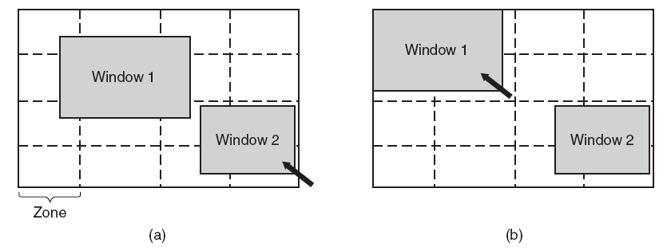
Power Management Display
Tanenbaum, Fig. 5-46.
The inactive zone (zone out of pointer) can be dark
The active zone must be fitted into the minimize zone by the window managers using the snap-to-zone in automatically
→ reducing of power
More sophisticated, the window manager partial illuminate a window that was not completely full

Slide 116
Power Management Hard Disk
Takes substantial energy to keep it spinning at high speed, even if there are no accesses
Many computer spin the disk down after a certain number of seconds or minutes of inactivity. When it is next needed, it is spun up again
A stop disk is hibernating because it takes quite a few seconds to spin it up again, which causes noticeable delays for the user
Restarting the disk consumes considerable extra energy
In practice, most systems are conservation and only stop the disk after a few minutes of inactivity
Disk cache in RAM is used
If a needed block is in the cache, an idle disk does not have to be restart to read
If a write to the disk can be buffered in the cache, a stopped disk does not have to restarted just to handle the write
The disk can remain off until the cache fills up or a read miss happens
OS keeps running programs informed about the disk state by sending it messages or signals

Slide 117
Power Management CPU
A notebook CPU can be put to sleep software, reducing power usage to almost zero.
The only thing it can do in this state is wake up when an interrupt occurs
Whenever the CPU goes idle, either waiting for IO for no work to do, it goes to sleep
The CPU voltage can often be reduced in software, which save energy but also reduces the clock cycle (approximately linearly). Since power consumed is proportional to the square of the voltage, cutting the voltage in half makes the CPU about half as fast but at ¼ the power
Running slowly is more energy efficient than running quickly

Slide 118
Power Management Memory
There are 2 possible options
The cache can be flushed and then switched off
It can always be reloaded from main memory with no loss of information
The reload can be done dynamically and quickly, so turning off the cache is entering a sleep state
Write the contents of main memory to the disk, then switch off the main memory itself
It is hibernation since virtual all power can be cut to memory at the expense of a substantial reload time, especially if the disk is off too
When the memory cut off, the CPU either has to be shut off as well or has to cause it to jump to code in a ROM so the memory can be reloaded before being used
Despite all the overhead, switching off the memory for long periods of time may be worth it if restarting in a few seconds is considered much more desirable than rebooting the OS from disk, which often takes a minute or more

Slide 119
Power Management Wireless Communication
The radio transmitter and receiver required are often first-class power hogs
Solutions
The mobile computers communicate with fixed base stations that have large memories and disks and no power constraint.
Thus, this computer send a message to the base station when it is about to turn of the radio, then the base station buffers incoming messages on its disks
When the mobile computer switches on the radio again, it tells the base station, then any accumulated messages can be sent to it
Outgoing messages that are generated while the radio is off are buffered on the mobile computer. If the buffer threatens to fill up, the radio is turned on and the queue transmitted to the base station
When should the radio be switched off?
Let the user or the application program decide
Turn it off after some number of seconds of idle time
When should the radio be switched on?
Let the user or the application program decide
Switched on periodically to check for inbound traffic and transmit any queued message, or the output buffer is close to full

Slide 120
Power Management Thermal Management
Modern CPUs get extremely hot due to their high speed
Desktop machines normally have an internal electric fan to blow the hot air out of chassis
With notebooks, the OS has to monitor the temperature continuously
When it gets close to the maximum allowable temperature, the OS has a choice
It can switch on the fan, which makes noise and consumes power
It can reduce power consumption be
Reducing the backlighting of the screen
Slowing down the CPU
Being more aggressive about spinning down the disk

Slide 121
Power Management Battery Management
Smart batteries can also be instructed to change various operational parameters under control of the OS
Some notebooks have multiple batteries
When the OS detects that one battery is about to go, it has to arrange for a graceful cutover to the next one, without causing any glitches during the transition
When the final battery is on its last legs, OS warn the user and the cause an orderly shutdown making sure that file system is not corrupted

Slide 122
Power Management Driver Interface
The Windows system has an elaborate mechanism for doing power management called Advanced Configuration and Power Interface – ACPI
The OS can send any conformant driver commands asking it to report on the capabilities of its devices and their current states
This feature is especially important when combined with plug and play because just after it is booted, the OS does not even know what devices are present, let alone their properties with respect to energy consumption or power manageability
It can also send commands to driver instructing them to cut their power levels

Slide 123
Power Management Application Program Issues
Tell the programs to use less energy, even if this means providing a poorer user experience
This information is passed on when the battery charge is below some threshold. Then the program decide between degrading performance to lengthen batteries life or to maintain performance and risk running out of energy

Slide 124
Summary
Thin Clients
Power Management
Q&A

Slide 125
Next Lecture
Deadlock
Problems & Solutions
Other Issues
Live Lock
Two phase Locking
Communication Lock
Starvation

